Slide 1
Spotlight (Katas)
Solution Architecture Document Version 1.0
Revision History
Date | Version | Author | Description
5/26/2022 | 1.0 | Happy Path | Original Draft

Slide 2
Introduction
Background and Problem Statement
Diversity Cyber Council is a 501c3 Non-Profit that serves under-represented demographics in the tech industry by facilitating education, training, and staffing opportunities to establish a sustainable and diverse talent pipeline to the workforce. The vision is to enhance inclusion and representation in the tech industry through training, mentoring, networking, and visibility programs.
The decentralization and lack of support between nonprofits create gaps of service and overall impact. The lack of visibility of nonprofit groups and offerings creates a barrier of access to the people we aim to serve.
Scope of architecture
Developing an architecture for Nonprofit Networking Hub & Diverse Candidate Career Case Management Tool named Spotlight.
Out-of-Scope for initial architecture
Advertising Spotlight on other platforms
Automated integration with non-profit organization systems

Slide 3
Architecture Significant Requirements & Constraints
Architecture Significant Business Requirements
Users:
Non-Profit with offering (“Non-Profit”) – group with a platform integration offering
Candidate – consumer of non-profit offerings, delivered via the platform
Administrators – Management of the platform, registering Non-Profits
The Platform must establish a way to incentivize engagement such as sharing of resources, collaboration, networking, facilitating introductions, and partnerships.
The Platform must categorize/tag nonprofit support services to match candidate needs identified in the onboarding assessment to include but not limited to: Resume Writing Services, Interview Prep, Free Business Attire, Apprenticeship Program Registration, Training Program Registration, College & University Registration, Free Grocery & Meal Services, Discounted Rent & Housing Services, Daycare/Chile Care Services, Mentorship/Career Advocate Services
Reporting
Architecture Significant Non-Functional Requirements
Multi-language support
System SLA and volume is not known, hance, the architecture is designed to be flexible and extensible to meet various SLA needs and simple to start with
Low cost and easy to maintain

Slide 4
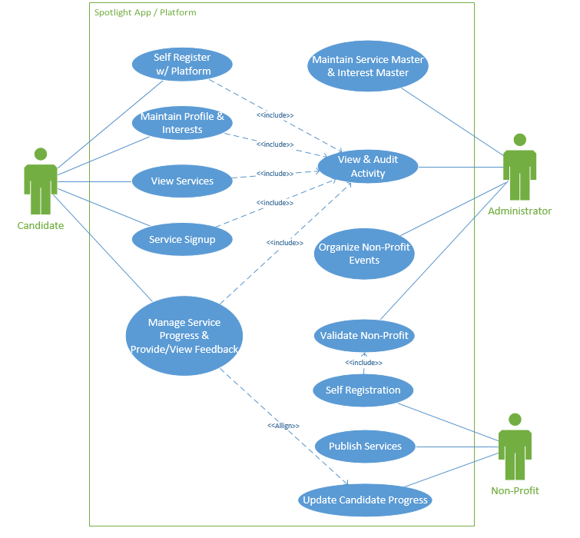
Critical Use-Cases

Slide 5
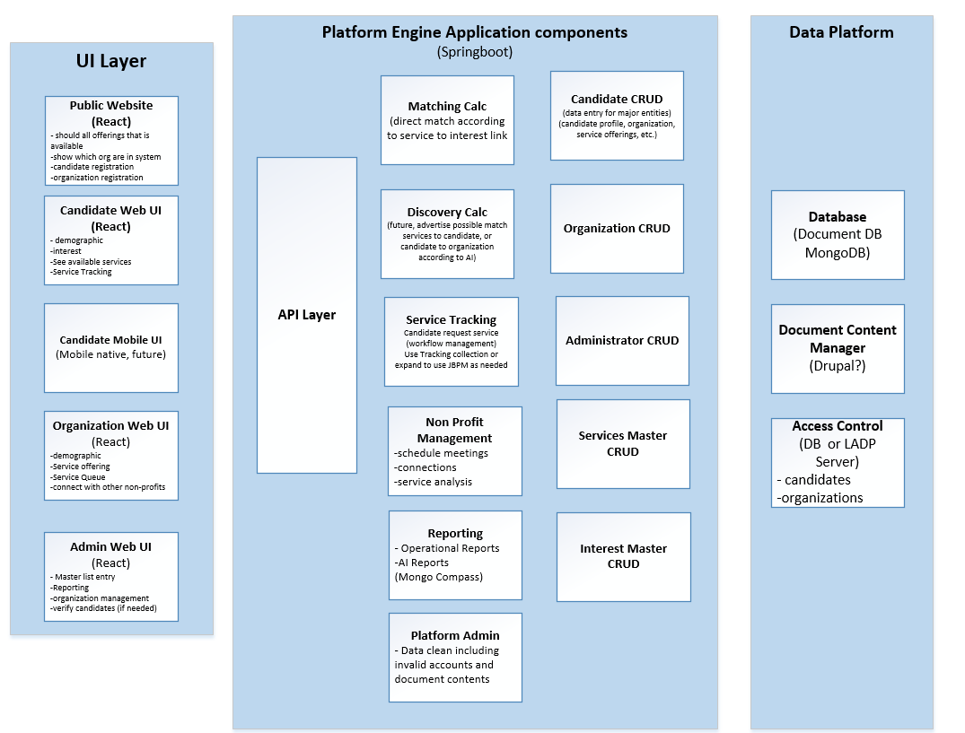
Application Component View
Key Design elements:
Application components are stateless services with matching data persistent document collections
Matching Calc, Discovery Calc, Service Tracking, Reporting will also have features that can be run in nightly batch mode to find matches or clean up data
For ease of use, multiple user specific UI can be built on top of the same API layer
For ease of use, multi-language support is built into the system and data captured in the database tables (document collections)

Slide 6
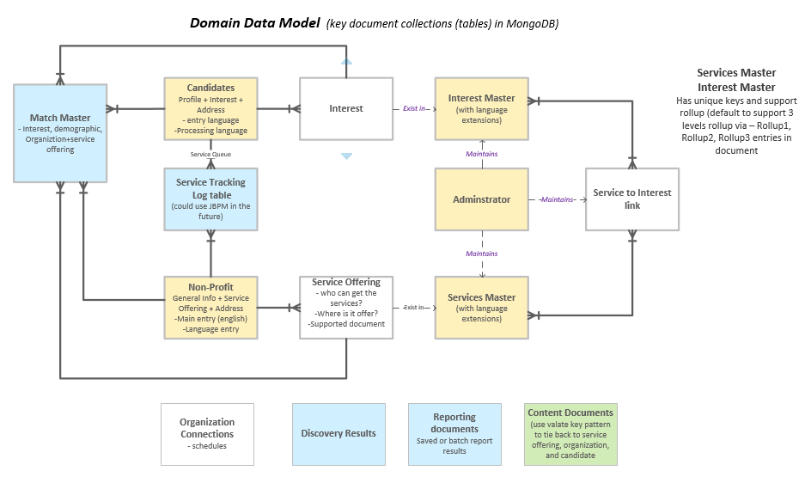
Data Model
Notes: blue=for business service components; yellow=for domain entities;green=document;content

Slide 7
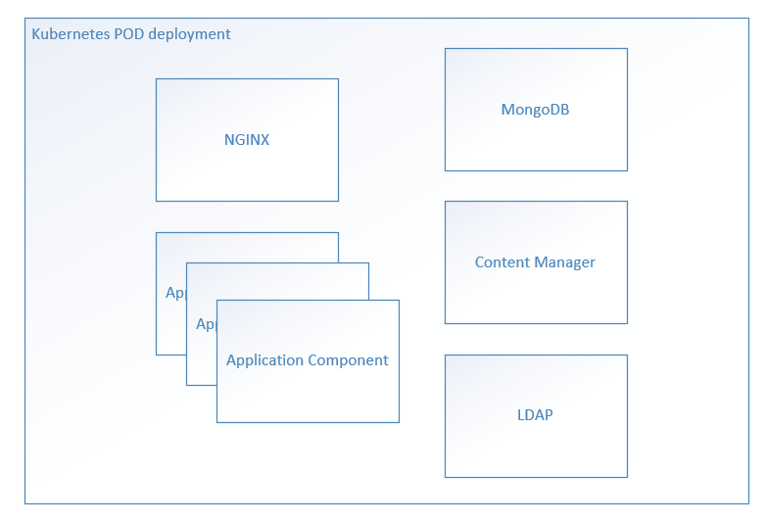
Deployment View - Logical
Deployment View and Scalability
All React components will be in a single Docker Image using NGINX as Web Server
All Application components will be in a single Docker Image. Application components are designed to be stateless
Each deployment model can scale independently
With the simplistic approach, the platform could be deployed as traditional web app, in Kubernetes or Serverless model

